Slide 1

Heredity and Evolution
Mechanism of heredity

Slide 2
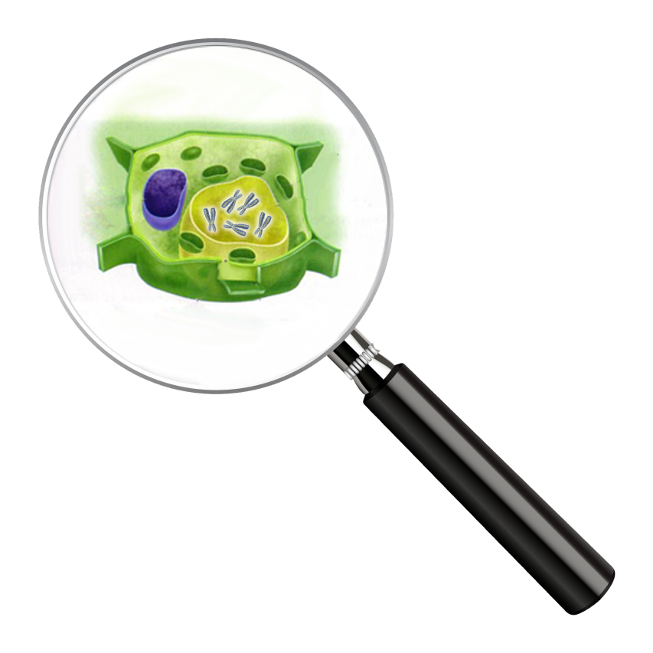
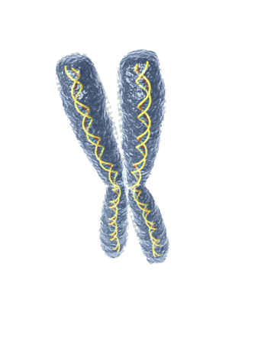

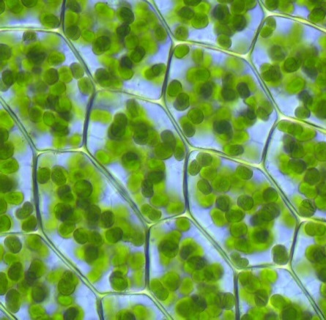


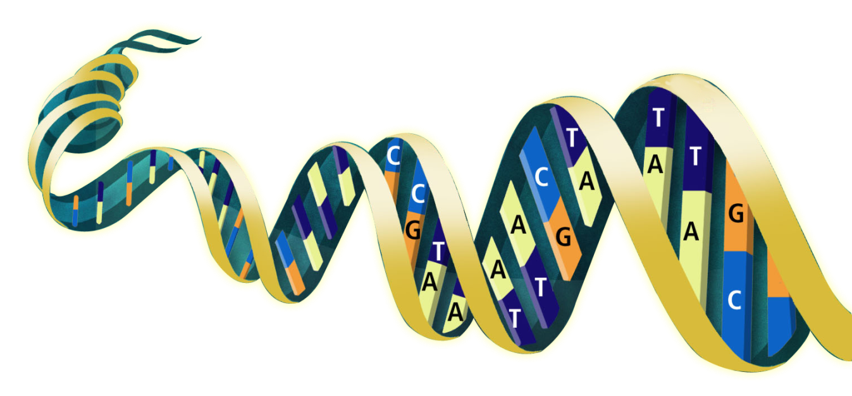
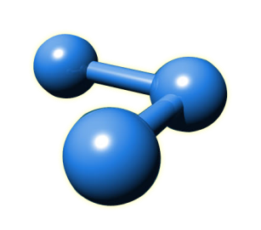
How does the mechanism of heredity work
Cell
Chromosome
Gene codes for protein
Gene
DNA
Protein forms a character
Character
Protein/Enzyme

Slide 3

Lets understand the mechanism of heredity with an example

Slide 4

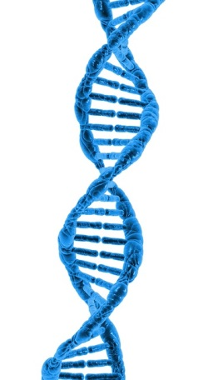

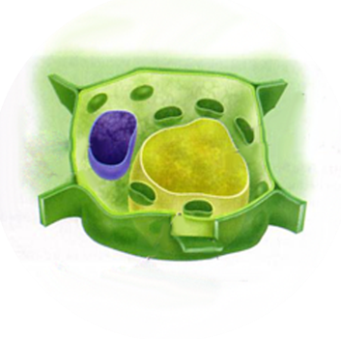


How does the mechanism of heredity work
Cell
Chromosome
Nucleus
DNA
Genes
Gene codes for an enzyme which is responsible for tallness in plant
This enzyme produces a hormone which triggers plant growth and results in tallness in plant
Protein/Enzyme

Slide 5

How does the mechanism of heredity work
If the gene has an alteration
Cell
Chromosome
Nucleus
DNA
Genes
It makes the enzyme less efficient and hence produce less hormones
Protein/Enzyme
So the plant will be short

Slide 6
Thank You

